Slide 1
Ethereum Historical Data
By Arnav Dashaputra

Slide 2
Source
https://www.kaggle.com/kingburrito666/ethereum-historical-data
The data is clean, and has 1,165 individual entries in the specific dataset I chose to study.
Dataset attributes: Date in UTC, Unix timestamp, price values.
The date in UTC/Unix timestamp showw the individual day that a value of Ethereum was recorded.

Slide 3
Ethereum Historical Data
The data that I have selected to visualize in this assignment is Ethereum historical data.
Ethereum is a digital or virtual currency created in 2013 that uses peer-to-peer technology to facilitate instant payments. As with any currency, the value of Ethereum increase and decreases, sometimes dramatically, over time.
The data comes from Kaggle user Liam Larsen, and was awarded a usability rating of 6.5.
This data was collected from a personal source, though the price and exchange data of Ethereum at any given time is public information.

Slide 4
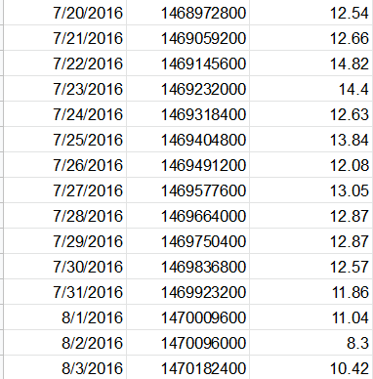
Data snippet
screenshot
The data has been collected from 07/30/2015 up till 10/05/2018.
Data has been collected at one-day intervals, and records the open, high, low, and close prices of Bitcoin.
The archive of data includes individual csv files for each column, I chose to focus on the average price history column. This is why the data only shows as three columns for now.

Slide 5
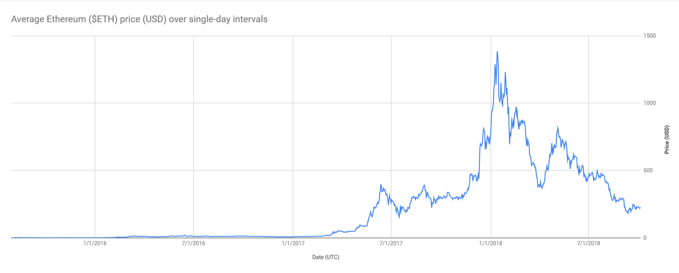

Slide 6
Why is this data interesting?
This data also shows how successful a specific crypto market can become at the expense of third-party influences, such as the successes and failures of other currencies, and restrictions/freedoms put in place on the market. Specific instances include a sharp increase in price, or more importantly, a sharp decrease or day of initial decline.

Slide 7
How can this data be used?
What questions can be answered using this dataset?
Although this dataset was captured a few years in the past, financial advisors and cryptocurrency investors can use the data trends of ethereum to make decisions and chance investments. Data trends like this can also be used to predict how the market will fluctuate, with ethereum being extremely popular among hardware miners and traders alike.
This dataset can be used to answer questions regarding the long-term impacts of regulations or freedoms being put on the market (e.g., the increase of mining hardware costs making ethereum more difficult to obtain naturally). It can also be used to predict future costs, as stated above. I hypothesize that the price of ethereum would stay relatively low after its large spike in early 2018.

